Slide 1







Zomato Analytics Dashboard
HIMANSHU JOSHI

Slide 2



Introduction
Project Zomato Analytics deals with the Zomato restaurants, mapped all over the globe, analyzing which we can evaluate the country specific performance of Zomato on the basis of key parameters like location, cuisine, average cost, online delivery and table booking. It will support the business decisions by identifying areas of improvements and providing key insights for informed decision making.

Slide 3

Objectives
01
Identify Key Performance Indicators
02
Calculate numbers of Restaurants based on City and Country.
03
Calculate numbers of Restaurants opening based on Year , Quarter , Month
04
Finding count of Restaurants based on Average Ratings
05
Percentage of Restaurants based on "has Table booking" and "has Online delivery"
06
Create buckets based on Average Price of reasonable size and find out how many restaurants falls in each buckets

Slide 4

Data Overview
Zomato Analytics features-
country table,
currency exchange rate table,
calendar table,
restaurants table.

Slide 5

Process Involved
Import data
Data modelling (connecting tables)
Data cleaning
Identifying Key Value Indicators
Identifying important columns
Analyzing and creating calculated measures/columns
Treating nulls and missing values
Visualizing the data

Slide 6


Tools Used
SQL to fetch data from the databases.
Power query editor to transform the data.
Excel & Power BI to analyze the initial patterns and identify the key performance indicators.
4.Power BI Dax to make calendar table.
5.Power BI & Tableau for visualizing and dashboarding.

Slide 7
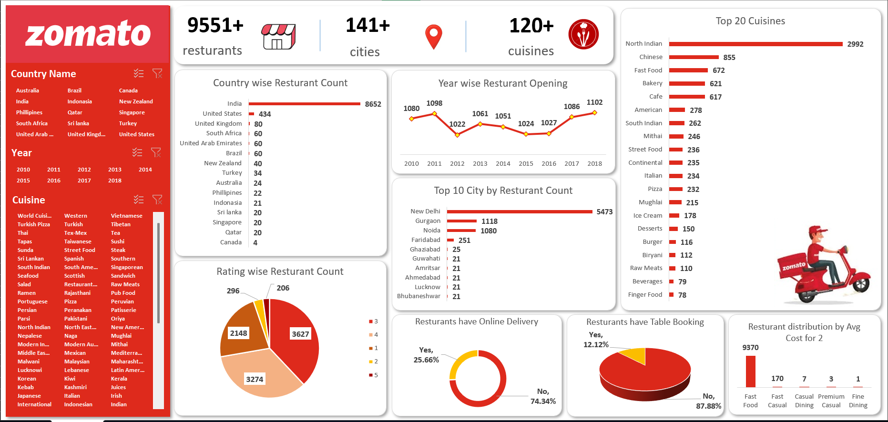
Excel Dashboard

Slide 8
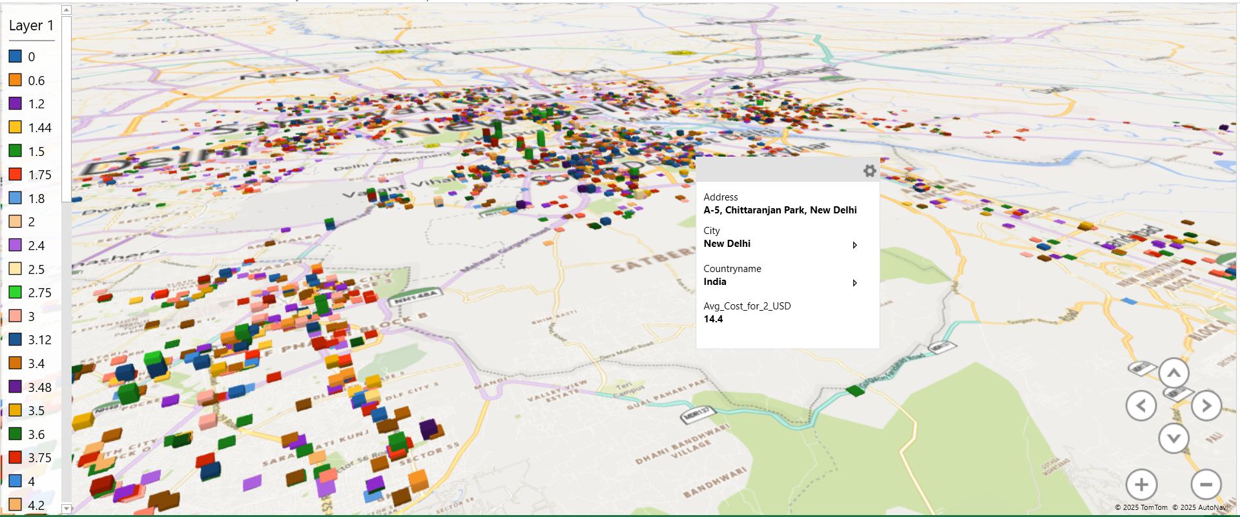
Excel Dashboard
Features:
3D Map in Excel

Slide 9
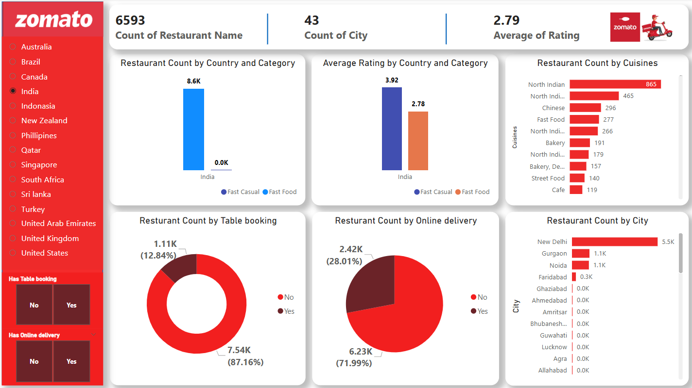
Power BI Dashboard

Slide 10
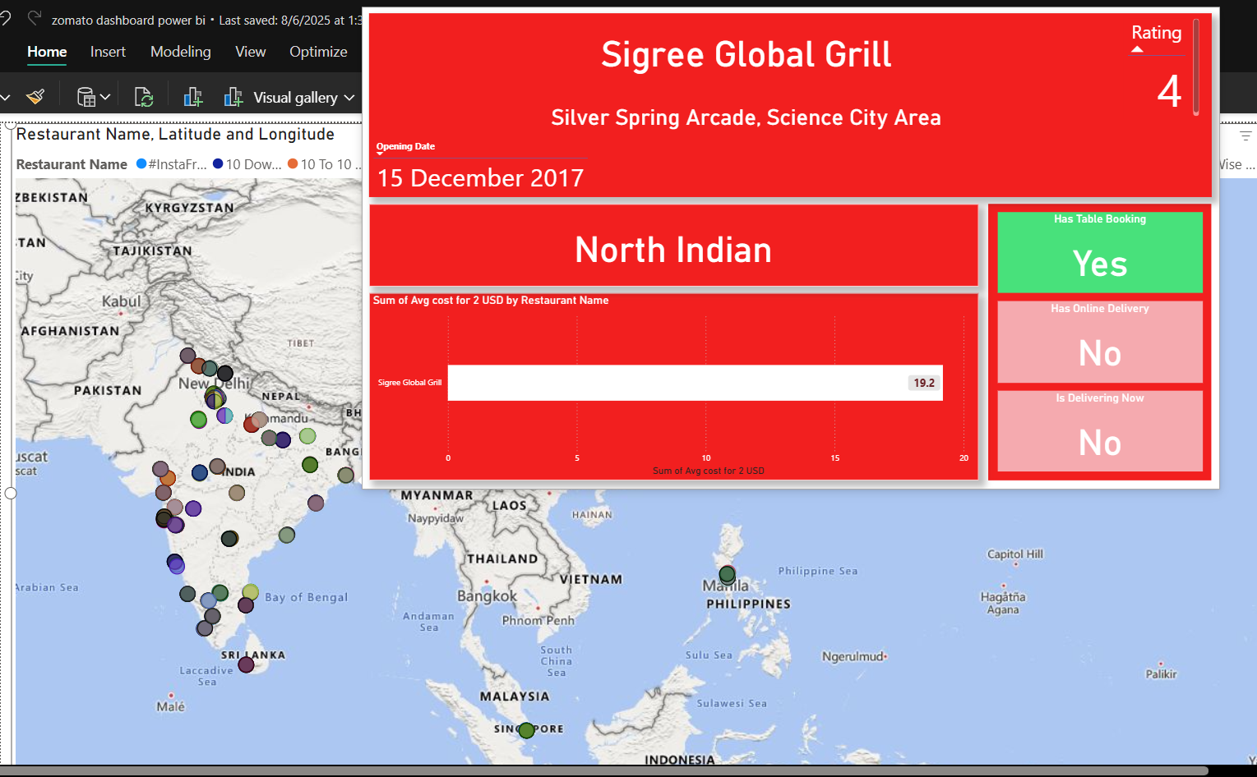
Power BI Dashboard
Features:
Map
Advance Tooltip

Slide 11
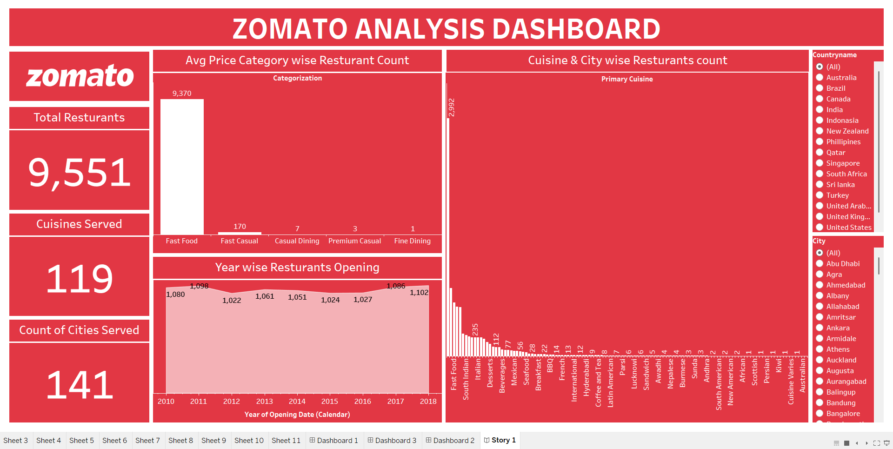
Tableau Dashboard

Slide 12
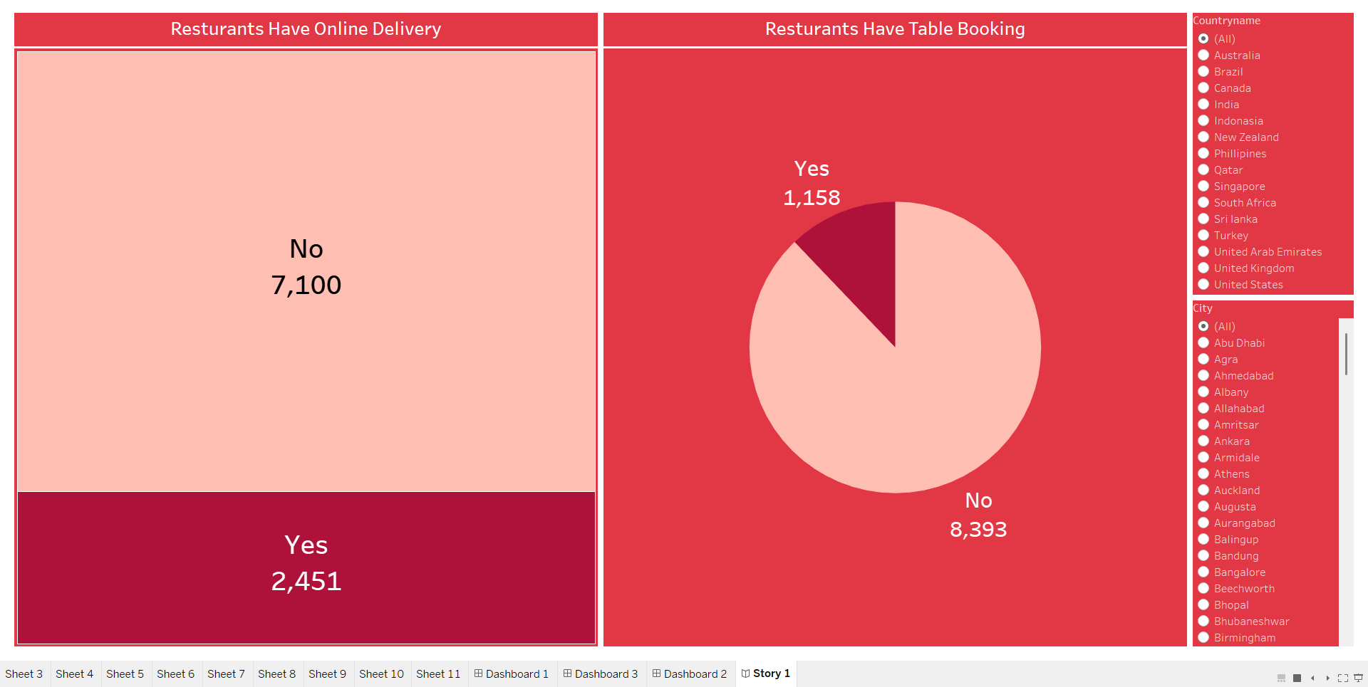
Tableau Dashboard

Slide 13
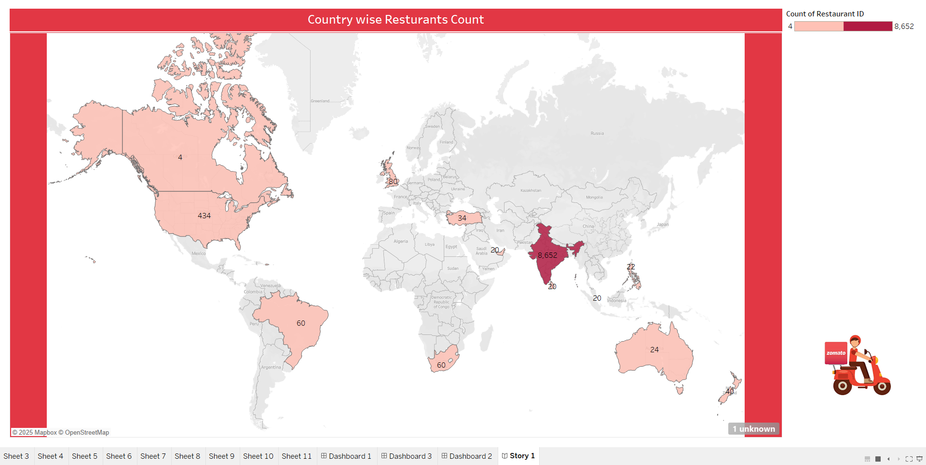
Tableau Dashboard

Slide 14


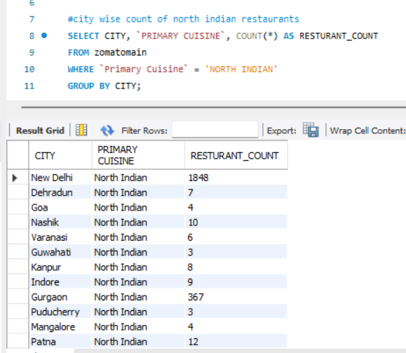
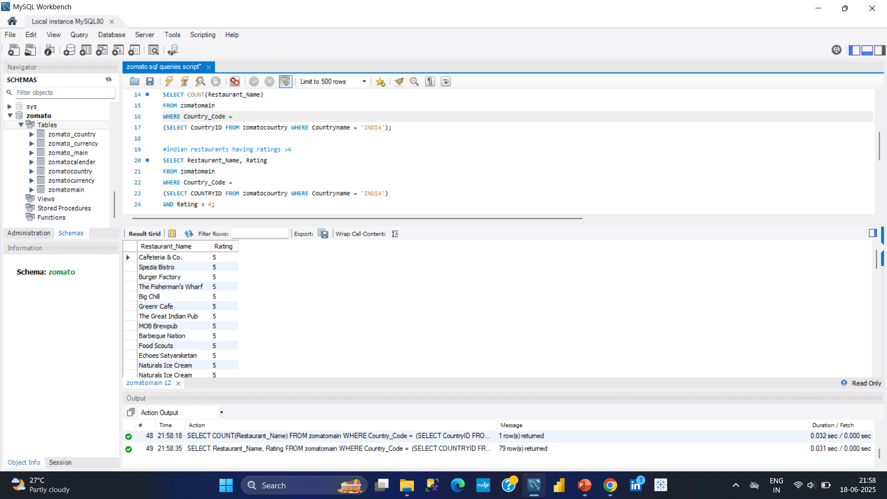
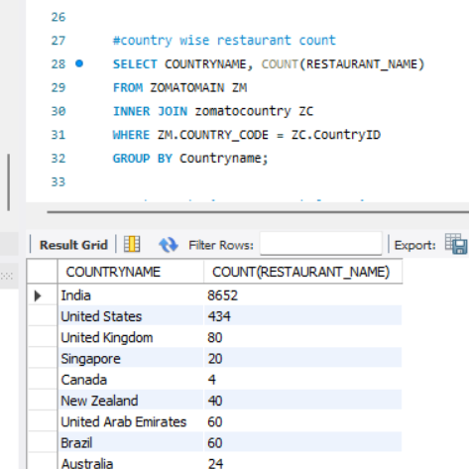
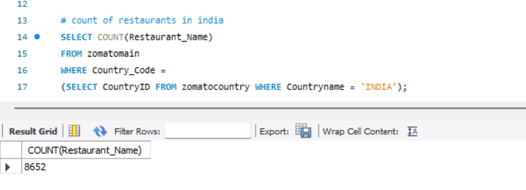
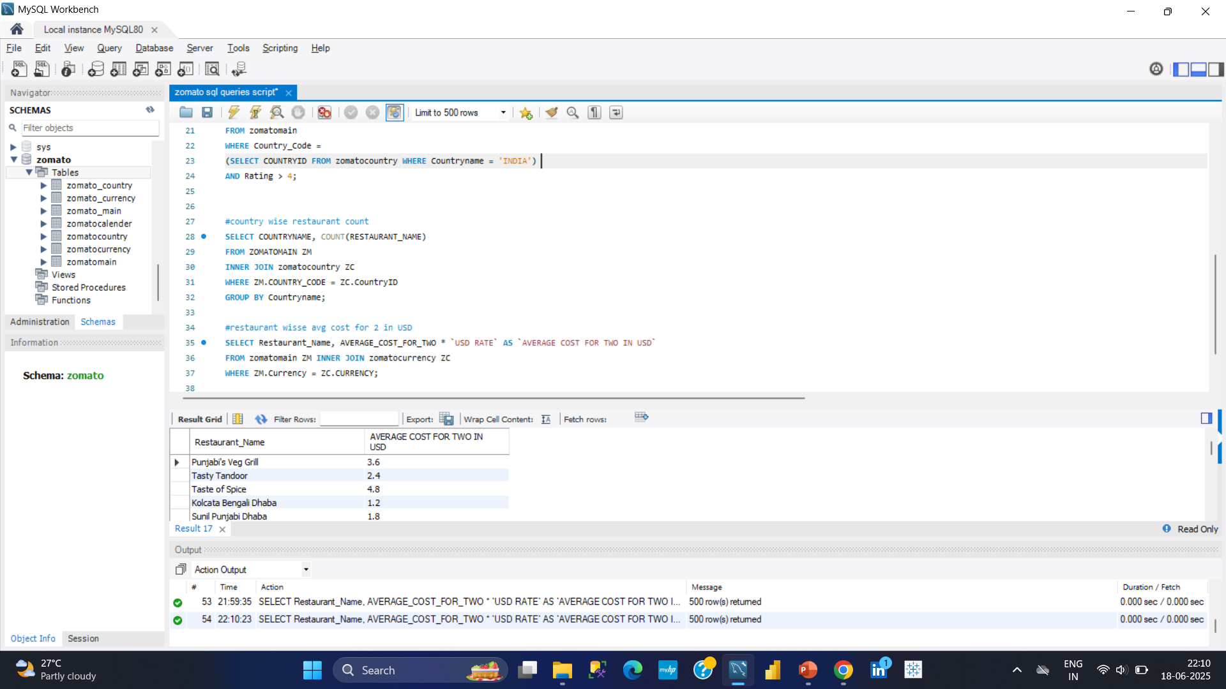
SQL

Slide 15


Insights
01
Zomato, being an Indian startup, has primary footprints in India. But limited to major cities.
02
It has a good business in USA as well. But spars in Europe.
03
In most of the countries online delivery and table booking facilities are not available or limited to a few restaurants.
04
In India, average rating for economy restaurants is 2.79 which should be improved.
Year wise new restaurants listing has no significant jumps in past years.
05
06
Most of the Indian restaurants are serving North Indian cuisine, need to diversify.

Slide 16


Recommendations
1. Need to expand to tier 2 and tier 3 cities in India. It will give a major boost to Zomato.
2. There is a huge potential in USA, Europe, East Asia and Australia for Zomato.
3. Should work on online delivery and table booking facilities.
4. Ratings of Indian restaurants shows the room for improvements.

Slide 17

Summary
This project is about Zomato restaurants, analyzing which I learnt how to analyze restaurant data and collect insightful trends and patterns which can lead to the data driven decision making.
I got the hands-on practice of tools like Advance Excel, power query editor, pivot table, data modelling, Power BI, Dax, drill down, drill through, SQL etc.
I learnt how to perform data cleaning, treating null values and handling blanks, merging tables, analyzing data, identifying important columns and key performance indicators, visualizing the data and dashboarding.
I would like to further contribute to the data driven industry and unravel the hidden patterns and trends that it can become the growth engine for the company.

Slide 18
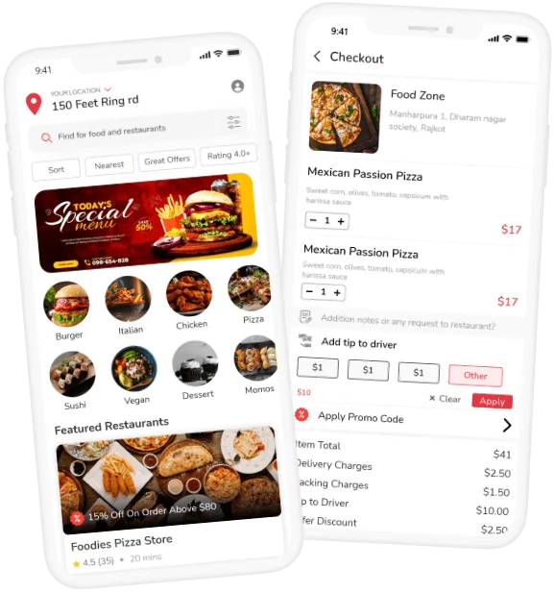
Thank You
Himanshu Joshi

